Slide 1
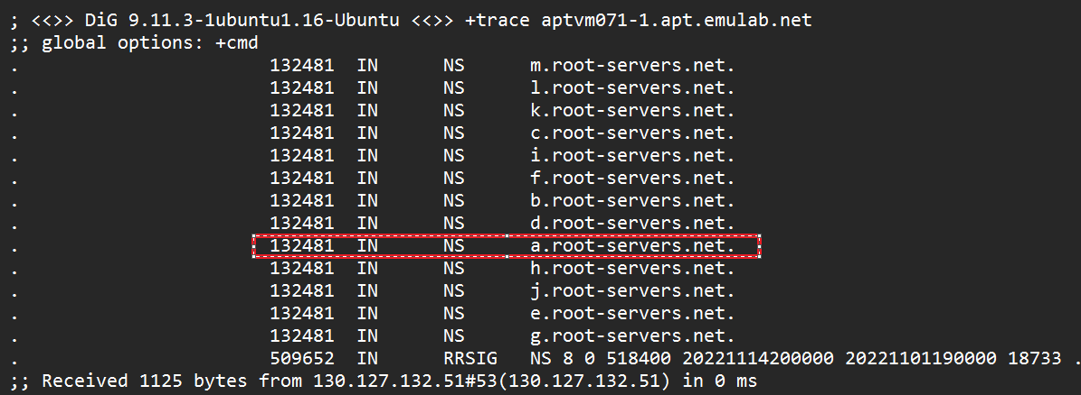
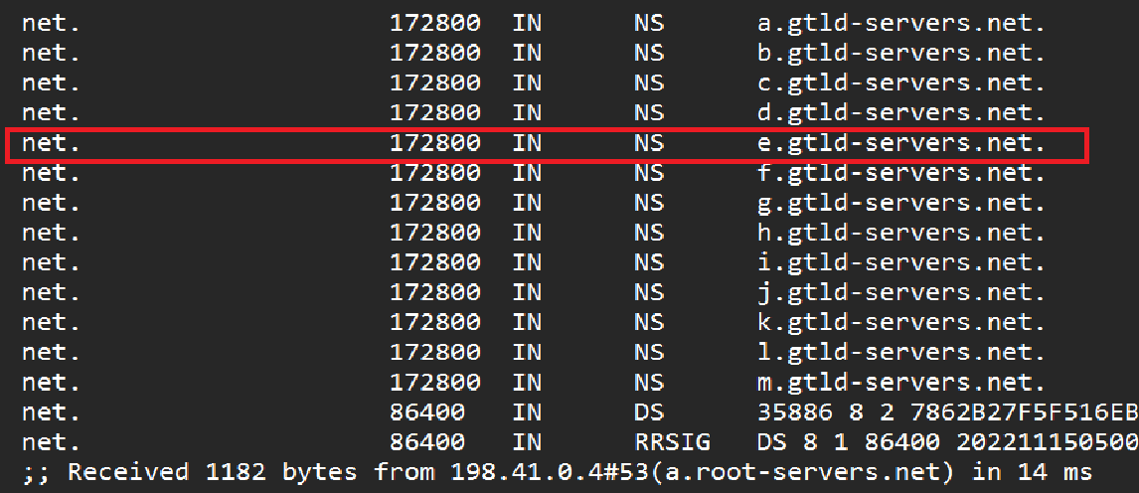
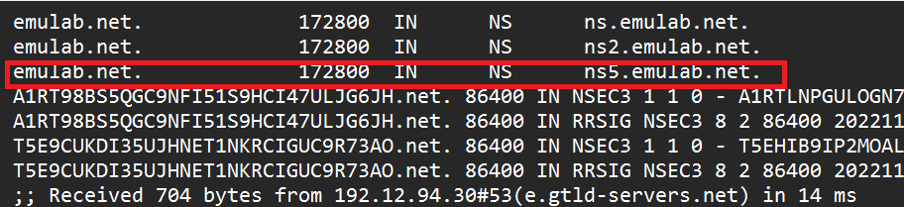
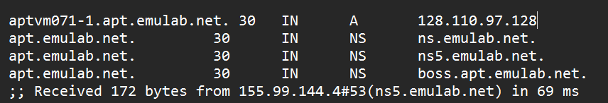
Querying: a.root-servers.net
Querying: e.gtld-servers.net
Querying: ns5.emulab.net
Finally, from "ns5.emulab.net" we get the address of aptvm071-1.apt.emulab.net.

Slide 2
Client
Gateway
Server
192.168.100.160
192.168.100.1
130.127.132.207
128.110.97.128
1) Client on LAN opens a connection to host on WAN
FROM: 192.168.100.160:60340
TO: 128.110.97.128:80
2) If new connection, NAT device adds to translation table
LAN IP | LAN PORT | WAN IP | WAN PORT
192.168.100.160 | 60340 | 130.127.132.207 | 60340
3) NAT device rewrites packet header, forwards on WAN
FROM: 130.127.132.207:60340
TO: 128.110.97.128:80
4) Response arrives at NAT from server
FROM: 128.110.97.128:80
TO: 130.127.132.207:60340
5) NAT device rewrites packet headers according to translation table, forwards on LAN
FROM: 128.110.97.128:80
TO: 192.168.100.160:60340

